Slide 1



Cumbria Children’s Voluntary & Community Sector Reference Group Meeting
14 February 2017
Bruce Lawson
Senior Manager Active Cumbria
Notes:
Thanks for the opportunity for me to come along today.
I’ve prepared the following presentation to help you understand a little more about Active Cumbria, but more importantly share some key information about Sport England, its new strategic approach and how it is proposing to invest over the next 4 years.

Slide 2
Active Cumbria -
Who We Are?
Our Role
Our Hosting within CCC
Partnership Steering Group and Core Team
Part of a national network of CSPs
Our Strategy for Sport & Physical Activity
Core Funding from Sport England
Programme Funding from Sport England
Notes:
To help set some context, I thought it would be beneficial to first explain ‘who were are’?:
Active Cumbria is the Sport and Physical Activity Partnership for the county.
We’re responsible for encouraging people to lead healthier and active lifestyles. We look to tackle inactivity through strong leadership and positive customer experiences.
Active Cumbria has been hosted by Cumbria County Council since it was established back in 1999. We’ve been hosted in various Directorates over the years -Children’s services, Adult & Local Services and now Health & Care Services.
Active Cumbria is led by a strategic Partnership Steering Group chaired by Jason Gooding, CEO for CCC and is supported by a core team of 11 professional staff.
As one of two Senior Managers, I report to Colin Cox, Director of PH.
We also belong to a family of 45 County Sport Partnership teams located across England, providing an effective national network linked to national policy makers.
Active Cumbria is delivering the last year of its current 4 year Sport and Physical Activity Strategy which provides us with the strategic direction and sets out a series of key ambitions . We’re already working on a new strategy through to 2021.
Roughly 60% of our funding comes via Sport England from national lottery & Government Departments. As a result, a lot of our work areas are pre-determined so that we meet the requirements of this funding.
We work to a Core Services Specification with Sport England, where we provide a range of support services for local government and national governing bodies of sport.
We’re also funded to deliver on many other projects, programmes and events.

Slide 3
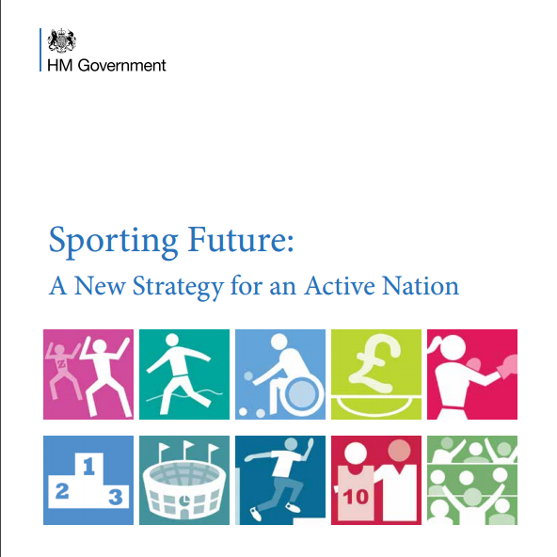
Sporting Future
Redefining what success looks like in sport by concentrating on five key outcomes:
  physical wellbeing
  mental wellbeing
  individual development
  social and community development
  economic development.
Notes:
In December 2015, the Government published Sporting Future: A New Strategy for an Active Nation.
This sets a new bold and ambitious direction for sport policy.
It changes sport funding so it is no longer merely about how many people take part, but rather how sport can have a meaningful and measurable impact on improving people’s lives. Harnessing the potential of sport for social good.
There is now a stronger focus on targeting groups which have traditionally had lower rates of participation, namely:
Women & Girls
Older People
Disabled People
And those from lower socio-economic groups.
At it’s heart are five outcomes:
physical wellbeing
mental wellbeing
individual development
social and community development
economic development.
These outcomes will define who is funded, what is funded and where priorities lie in the future.

Slide 4
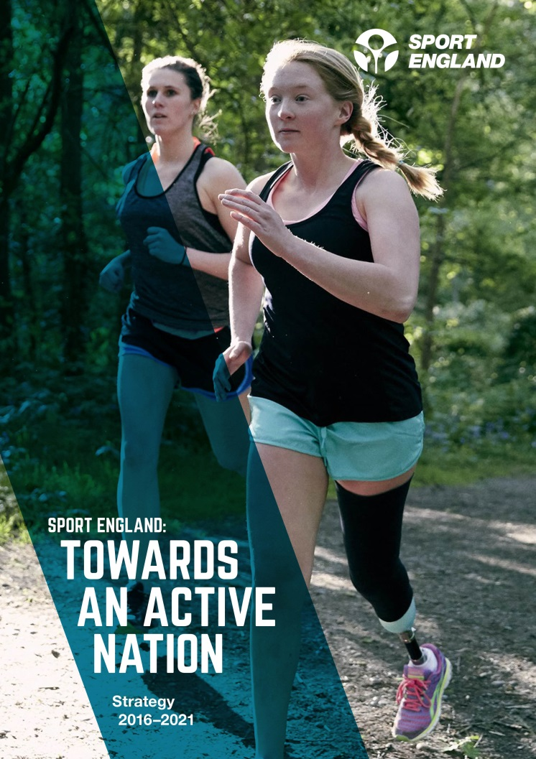
Towards An Active Nation
SPORT ENGLAND’S VISION:
We want everyone in England
regardless of age, background or level of ability to feel able to engage in sport and physical activity. Some will be young fit and talented, but most will be not. We need a sport sector that welcomes everyone – meets their needs, treats them
as individuals and values them
as customers.
Notes:
In May last year, Sport England provided their response to Government’s Sporting Future by publishing their new strategy: Towards An Active Nation.
You can see by their vision that they are continuing to invest in people who play sport and are active now including talented athletes, but there is a huge shift to encourage those who are inactive to become active.
The strategy also shows us that they are adopting completely new approaches, including a new set of investment principles, 7 new investment programmes (replacing the 30 odd they had previously) and adopting a new measurement system called Active Lives.
We know that Sport England is seeking to increase the number of people who engage in sport and activity, not for its own sake but for the wider benefits it can bring, in terms of physical and mental wellbeing and individual, community and economic development. They will now invest where the impact on these wider outcomes is the greatest.
We also know that that they are changing the balance of their investment. 25% of their resources over the next 4 years (£265 million) will be focused on tackling inactivity.

Slide 5
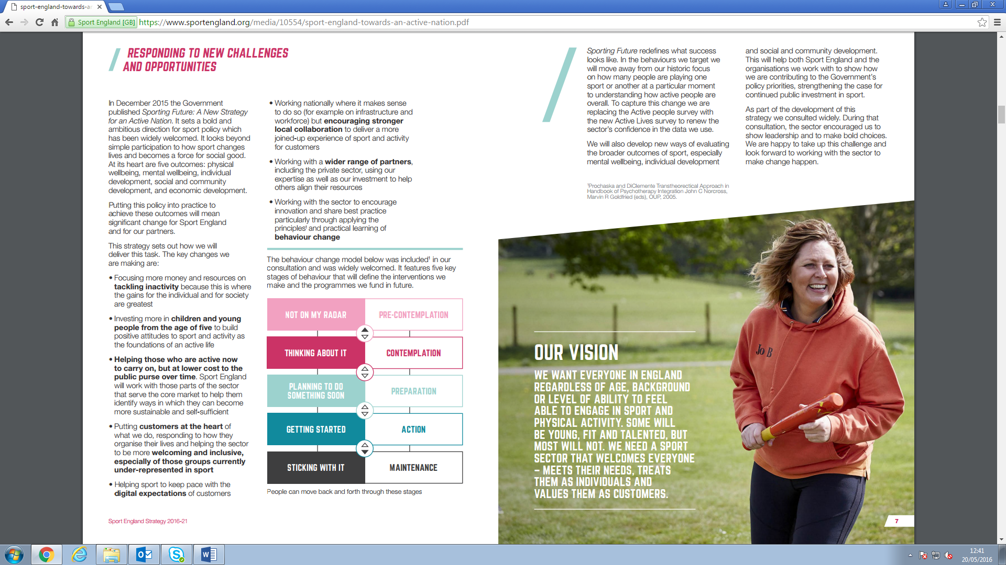
Towards An Active Nation – On A Page!
Outcomes
Physical
wellbeing
Mental
wellbeing
Individual development
Social and community development
Economic development
How we
think
Customer Focus
+
How we
decide
Seven investment principles
What we invest in
Inactivity
Children and young people
Mass market
Core market
Volunteering
Facilities
Local delivery
Underpinned
by
Workforce
Coaching
Active Lives
Notes:
On this slide, I’ve attempted to summarise their strategic approach.
You can see that their line of sight are the 5 Government Outcomes. Everything they do will contribute to one or more of these wider outcomes.
They are also putting customers at the heart of everything they do. Over the next 4 years they will work with the sport sector to make sure they are more welcoming and inclusive, especially of those under-represented in sport.
Equally, Behaviour Change – and the 5 stages of behaviour will define their interventions and the programmes they will fund in the future.
Sport England have created 7 investment principles. These will help to inform them on where to invest and how those investments will be supported and managed.
Sport England have also created 7 new investment programmes directly responding to the policy direction set in Sporting Future. These now replace the 30+ investment programmes they previously operated.
The 7 programmes are:
Tackling Inactivity
Children and Young People
Volunteering
Taking sport and activity into mass market
Supporting sport’s core market
Facilities
Local delivery
These 7 investment programmes are further underpinned by a new Workforce Strategy, A Coaching Plan for England and new approach to measurement – replacing Active People Survey with Active Lives

Slide 6
CYP Statements:
We Will……
Sport England CYP Statements (P 21 of the Strategy)
  Statement #1:
“Make a major new investment of £40 million into projects which offer new opportunities for families with children to get active and play sport together.”
CYP Investment Guide – Late February / Early March
Possible further funding into CYP via Tackling Inactivity or Mass Market Investments
Notes:
I’m sure you’re all delighted to see that Sport England has specifically targeted CYP for their own specific funding programme.
Throughout the Strategy, Sport England makes a series of ‘We Will’ statements. On page 21 of the strategy you can see 5 statements for Children and Young People.
On the screen is probably to most significant for you and your sector.
Only just a couple of weeks ago I attended a CYP briefing event for staff from County Sport Partnerships and received a ‘heads up’ on the fund that relates to this £40m investment.
At the end of February / early March Sport England will be publishing an Investment Guide for Children & Young People. It will present the insight on the market audience and the behaviours, attitudes and motivations of Children and Young People. It will also focus on the 5 ‘we will’ statements and how it will implement on these.
There is also the possibility that further funding may be announced into CYP via other Investment Programmes such as Tackling Inactivity and Mass Market.
Best bit of advice is to regularly watch the Funding page on Sport England’s website and to also subscribe to their e-newsletter which will advise on all new funding releases.

Slide 7
Families Fund
£40m – To work with new partners
Fund prospectus available late March
Followed by Workshops led by Sport England
Submissions of EOI
1st phase looking to ‘test and learn’
Broad definition of ‘Families’
Encouraging families to take part in sport together
3 areas of focus:
  The development of competence and confidence
  Promotion of enjoyment
  And avoidance of negative and bad experiences
Notes:
So let me provide you with some of the details of the ‘Families Fund.
The £40m fund will be used to work with new partners.
Likelihood of it being launched in late March with a funding prospectus, supported by Workshops for interested partners followed by submission of an EOI Form.
The 1st round of this fund will be to support the development of ‘Test and Learn’ projects.
The definition of ‘Families’ is in it’s broadest sense determined by the customer – what does a child think determines a family?
The fund will be used to support projects that encourage families to take part in sport and physical activity together.
The focus will be on:
The development of competence and confidence
Promotion of enjoyment
And avoidance of negative and bad experiences

Slide 8
Active Cumbria
Active Cumbria – a continued role to support CYP:
  Primary School Sport Premium
  Cumbria School Games
  Satellite Clubs
  100 Mile Challenge
  Scoping workshops to help facilitate collaboration and joined up local delivery
Notes:
I finally wanted to share with you some of Active Cumbria’s continued work areas that support Children and Young People.
We still have a role in supporting Primary Schools to deploy their share of the premium. In September schools will now have double the levels of investment due the Sugar Tax Levy coming into force. We do think there might be a future role for us in supporting the delivery of School Swimming and looking at ways for smoother transition from Primary to Secondary.
We will also continue to work with School Sport Partners in managing and delivering the Cumbria School Games.
Our successful delivery over the last 3 years of the Satellite Club programme will also continue albeit with some changes – perhaps targeting more the 14-25 year olds and having a strong focus on tackling inactivity and working with under-represented groups.
We will look to build on the number of Primary schools that we are working with on our 100 Mile Challenge. Presently 68 are involved in this academic year.
Lastly, as we have done with the Active Ageing Fund, we will look to host and facilitate a Scoping Workshop for local partners to explore ideas and opportunities to collaborate when details of the Families Fund are formally announced.

Slide 9
Thanks You
Q&A’s
Notes:
Thank you
Q&A’s

